Slide 1


Slide 2
What is panic button?
In panic button android application we have tried to make emergency calls to preselected people within one click of a button. On a single click of a button the person in requirement can send alert message, which will contain the current GPS location of the user in need. This message will be send to those users who are maintained in the preselected list of people.

Slide 3
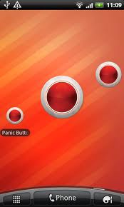
Introduction
The application main page looks like a photo which is meant to hide the fact that this is an alarm app. You will need to spend some time selecting emergency contacts, people you would want notify if you were ever in danger, and entering their contact information.

Slide 4
About the project
There is a main page where two main buttons are provided. The first button is Add Contacts and the other is Send SMS. Inside a button element you can put content, like text or images. The main components of the whole implementation are
(a)Add contacts
(b)Send SMS
(c)Delete Contacts
(d)Update Contacts
(e)Get GPS location

Slide 5
Add Contacts :
When the add button is clicked two text fields appears, in first textfield we write the name of the person and in the second textfield we add the phone number.
Send SMS:
Once the GPS location is obtained SMS are send automatically to all the contacts saved.
Delete Contacts:
We can delete any contacts from database by giving the contact name.

Slide 6
Update Contacts:
We can update any contact number.
Get GPS location:
Here we try to get the GPS coordinates by using certain functions to extract the longitude and latitude coordinates of the current place.

Slide 7
Working of project
Now on click of the button Add Contacts in the main window opens a new window. The first operation is to add contacts in the database SQLite .

Slide 8
When we click on the Panic Button a new window opens & the message with GPS location will be send to all the contacts saved.

Slide 9
To send SMS we have to set certain permission in the android manifest xml file .The permissions which are to be set in the android manifest xml are SEND SMS

Slide 10
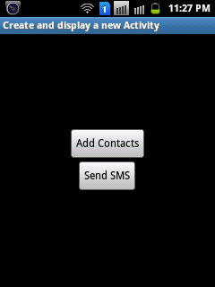
This is the front (Main) page of Panic Button.
Only two buttons are visible in the page.
Add Contacts
Send SMS

Slide 11
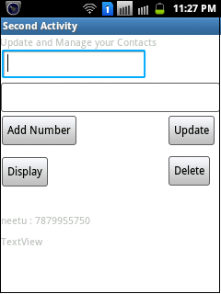
Here we can Add Contacts.
Update the previous entered number
Delete any Entry (Name + Number)
Name & Numbers in the database can be displayed

Slide 12
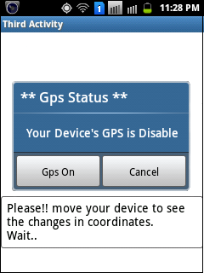
When the Send SMS button is clicked in the front page
It will open a new page, Requesting to Enable GPS. So that it can fetch current GPS location.

Slide 13
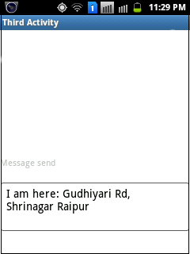
Just after we click Send SMS button in the front page current GPS location will be fetched and will be send in text form to all the recorded numbers in database.

Slide 14
Conclusion
The application enables users to push a central button and generate a security alert, activating immediate contact with various emergency services, providing instant details of location, as well as dialing emergency numbers and sending panic messages via a wide range of communication mediums and channels such as: Sms

Slide 15
THANKyoU

